Slide 1
Challenges and Solutions for Developing Urban Housing Projects By Arun Kashikar 20 Sept 2018

Slide 2
Huge latent demand for housing in India

Slide 3
Drivers – Growth of housing demand

Slide 4
Housing growth to be Volume Led

Slide 5
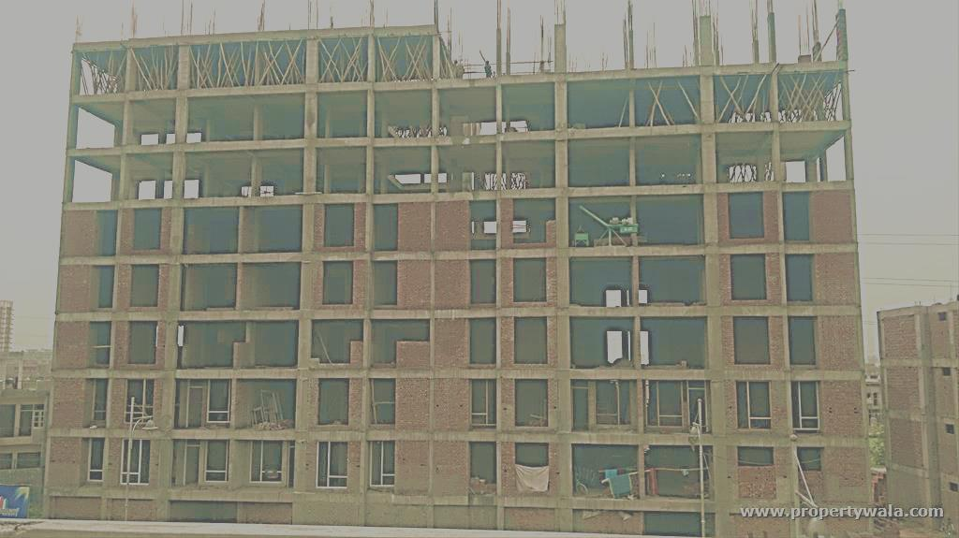
Conventional Technology

Slide 6
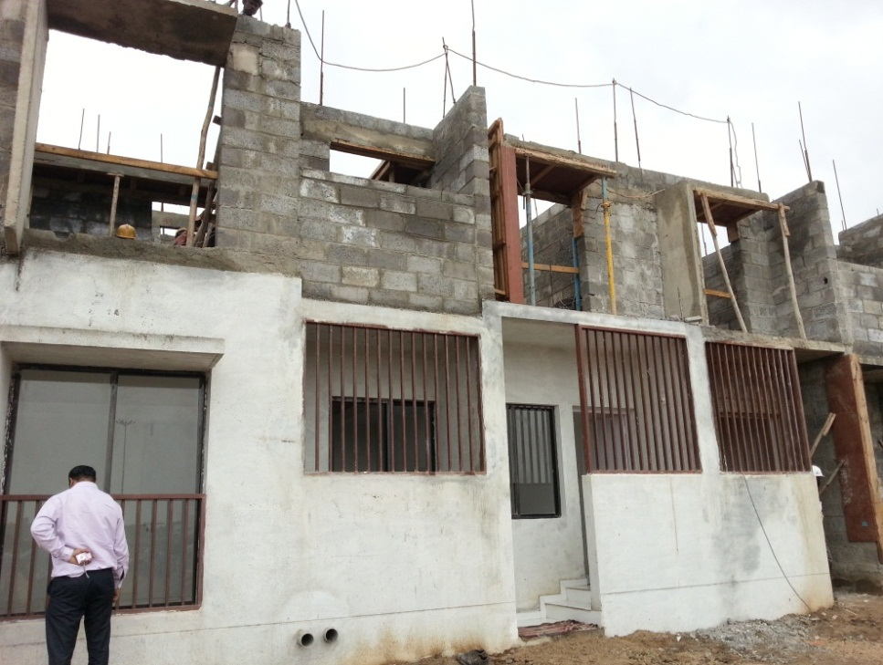
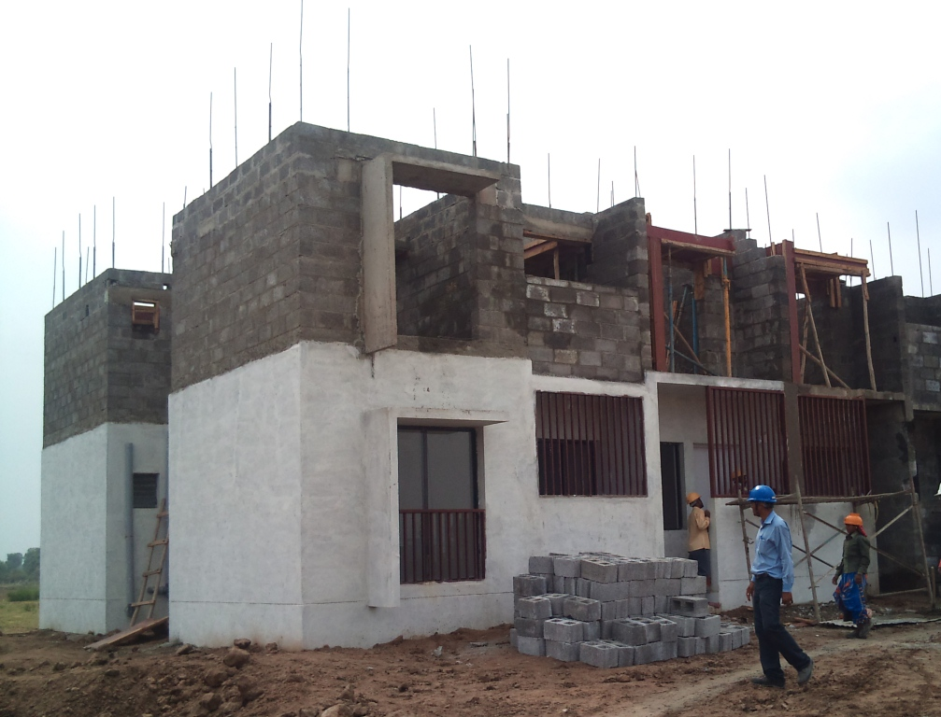
Reinforced Concrete Hollow Block with Precast Slab

Slide 7
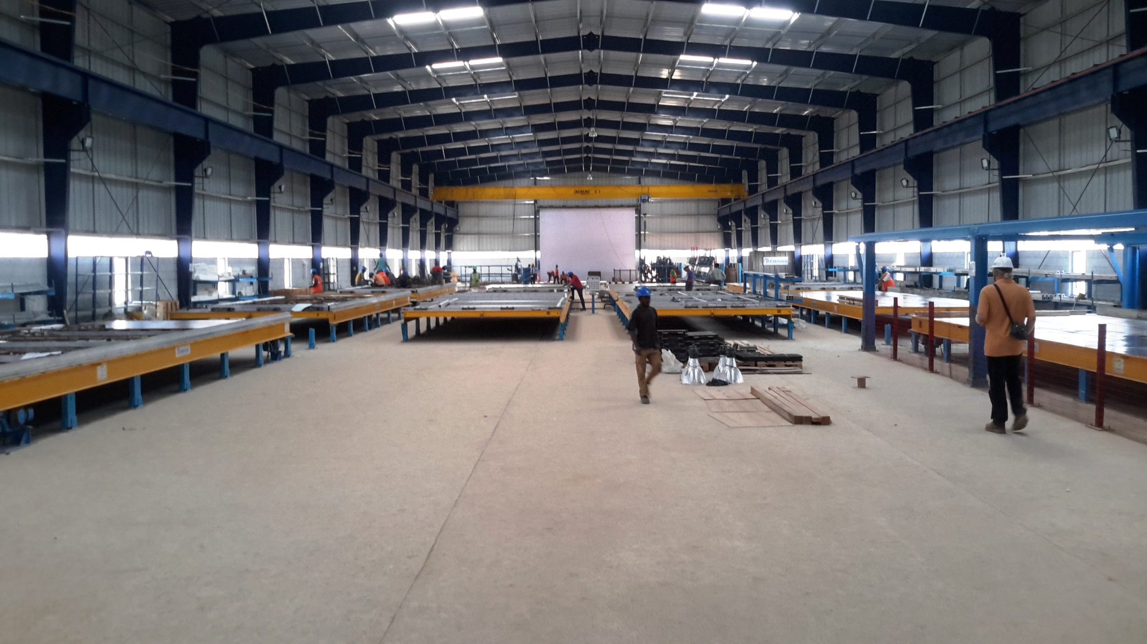
Precast Technology
Factory Set up
Notes:
Iteration

Slide 8
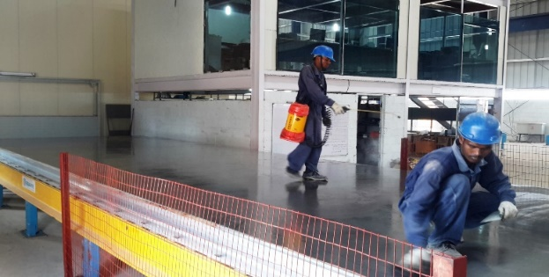
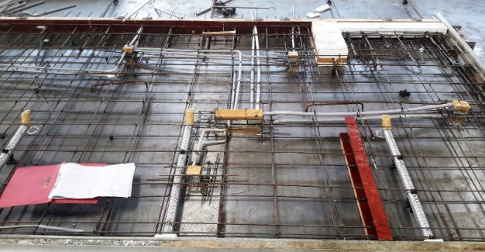
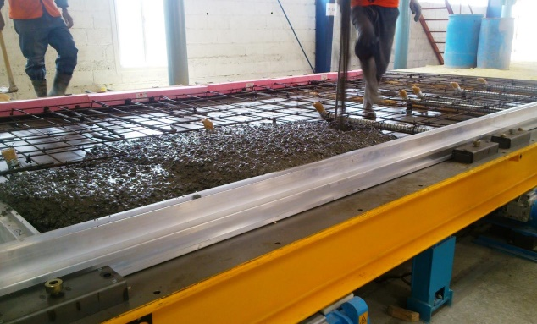
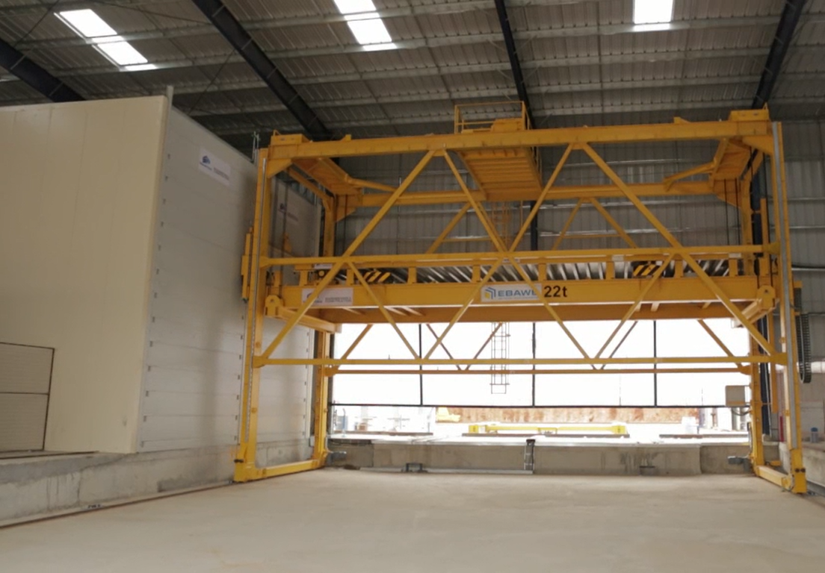
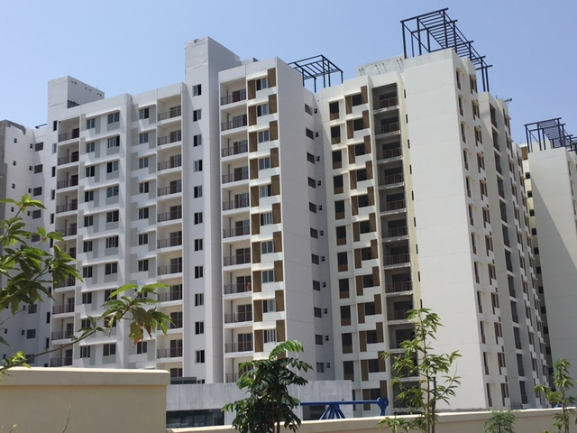
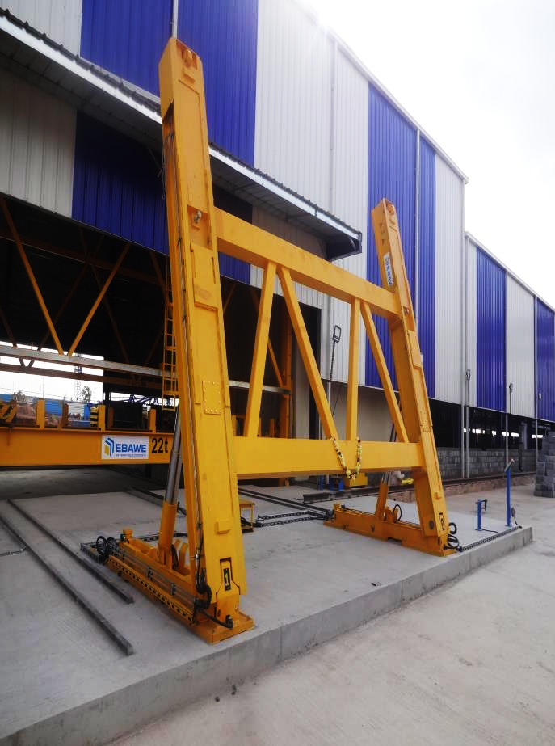
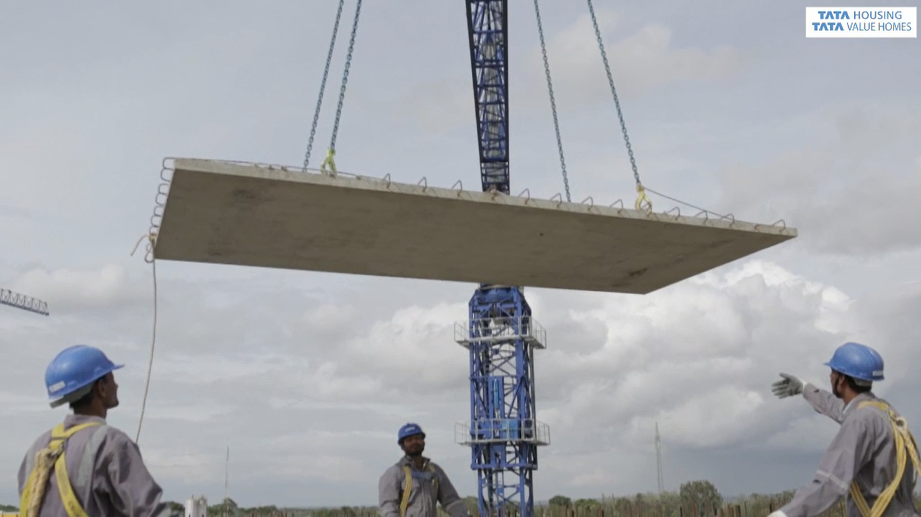
Element casting in precast factory…..
Notes:
Iteration

Slide 9
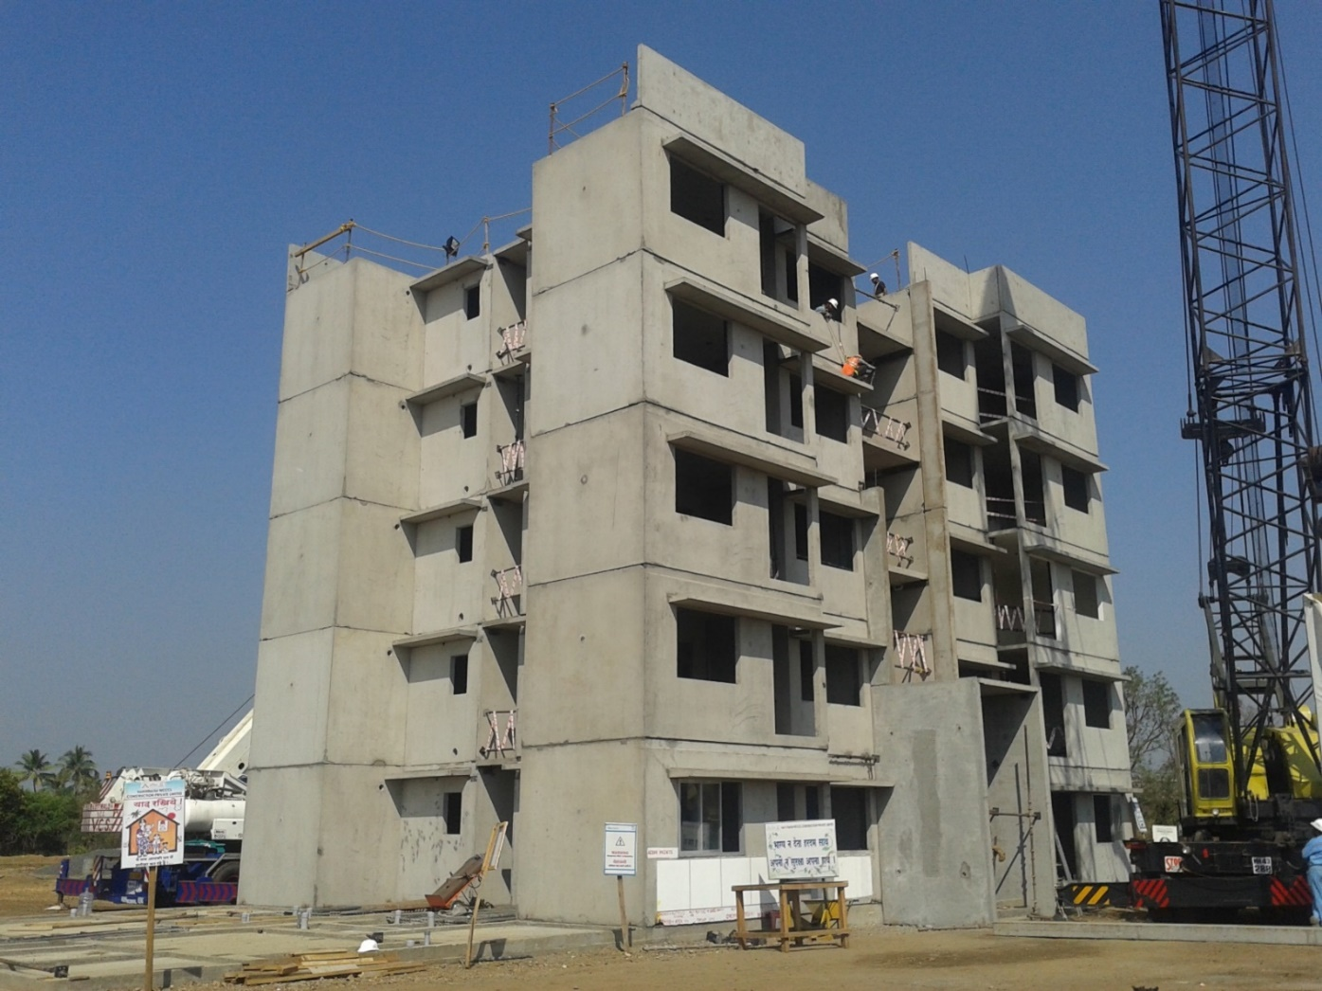
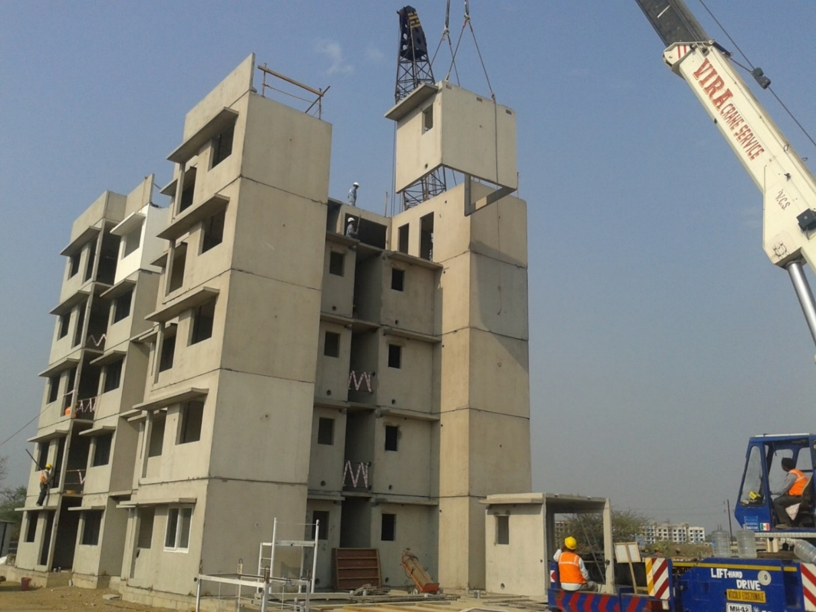
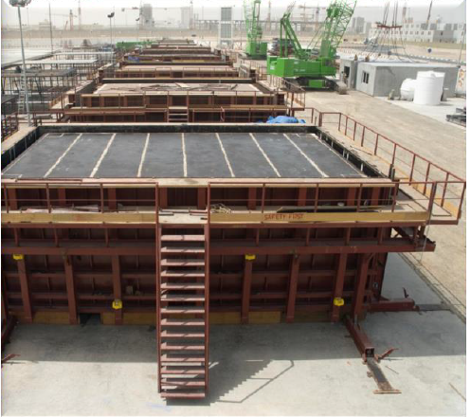
Volumetric Precast

Slide 10
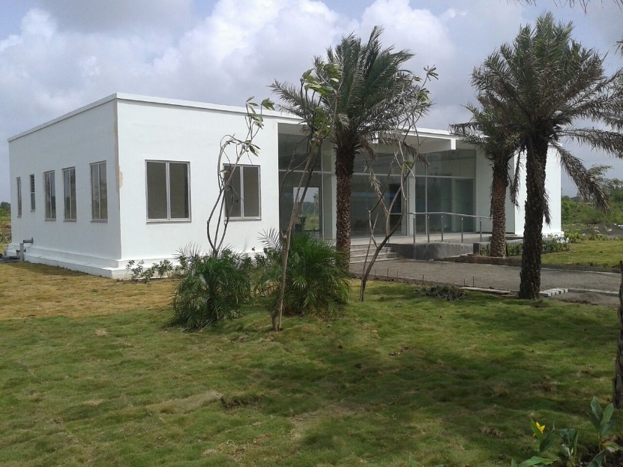
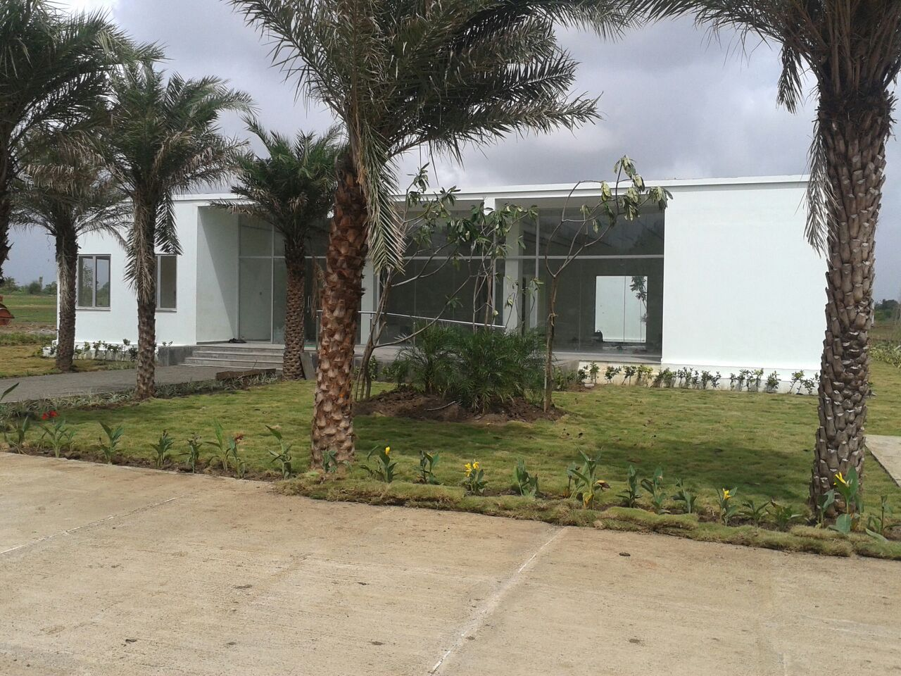
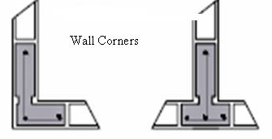
Glass Fiber Reinforced Gypsum

Slide 11
Infrastructure
Availability of utilities like water, electricity and Drainage in nearby vicinity
Availability of Garbage disposal arrangement
Disposal of excess treated STP water
Availability of city Roads to accommodate growth

Slide 12
Smart Homes …..
Comfort
Entertainment
Conservation
Convenience
Safety
The specific preferences of Smart Homes feature varies quite widely both within and across families

Slide 13
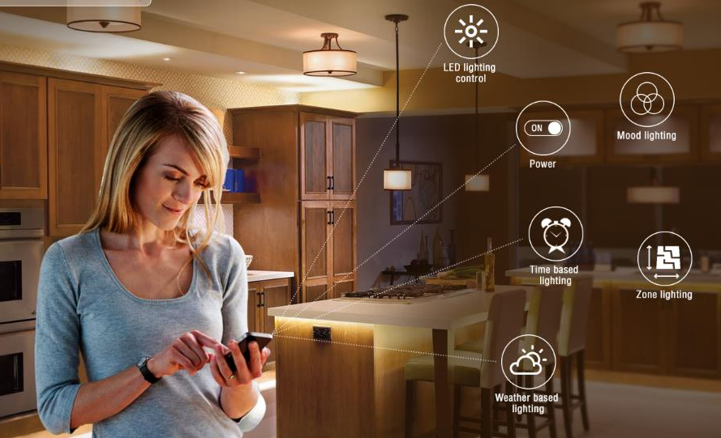
Smart Lighting System

Slide 14
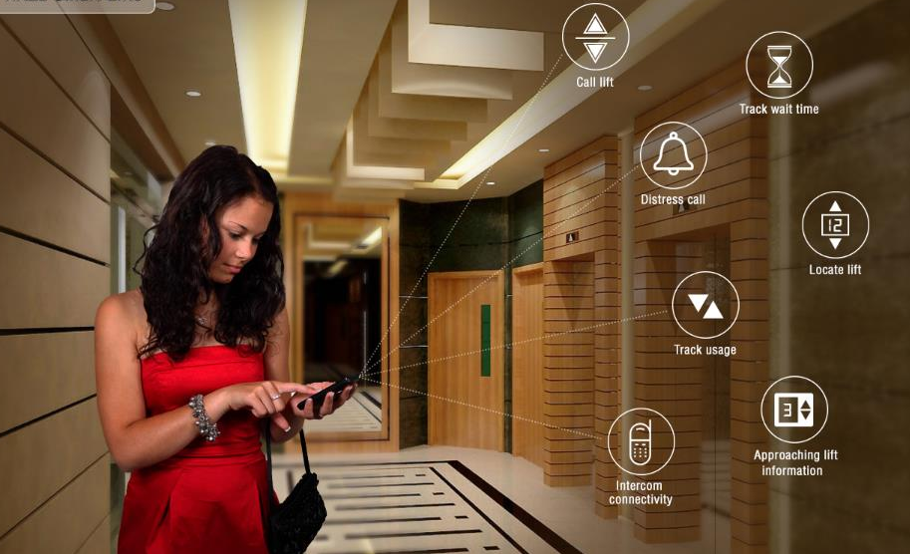
Smart Lifts

Slide 15
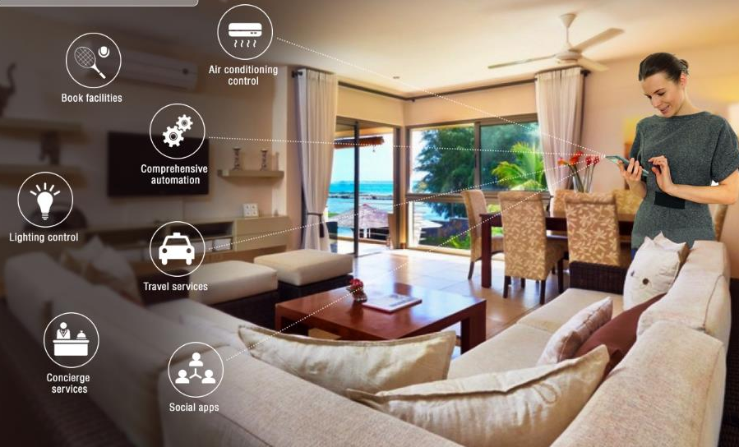
Integrated Apartment

Slide 16
Fountains and Amenities

Slide 17
Parking controll

Slide 18
Connectivity and missing standardisation
Internet Availability:
Connectivity and reliability
Bandwidth
Large variety of devices, link layer technology and protocols
Real-time seamless connections among various sensors and large number of heterogamous devices is a challenge
Interoperability
Most devices cannot share information and instructions with each other as there is no common protocol or real open system

Slide 19
Owning and Operating Cost
Cost of IOT enabled systems and devices:
Owning and operating, maintenance cost is still very high in India
Any change in device need customization by service provider making it even costlier
Awareness
Lower level of awareness on IOT or smart devices due to lack of vendor activity increases cost further limiting availability
Low level of adaptation by consumer

Slide 20
Smart Infrastructure availability
Availability of Smart Infrastructure
Smart Power Grid
Smart Drainage system
Smart Water Supply
Lack of skilled Resource:
Skilled resource is not available abundantly
User cannot setup himself if device brand or model is changed.

Slide 21
Cyber Security
Cybersecurity:
As smart home systems are interconnected wirelessly, there is risk of hacking into home infrastructure
Camera inside house prone to compromise privacy

Slide 22
Thank you

